Slide 1

RAJASTHAN INSTITUTE OF ENGINEERING AND TECHNOLOGY, JAIPUR
INNOVATION & INCUBATION
CENTRE OF EXCELLENCE
PRESENTATION ON THE TOPIC
Steganography of audio file using Python
SUBMITTED BY:-
Punit Pradhan & Rajiv Khanduja

Slide 2

A
Project Presentation
on
Steganography of audio file using Python
Submitted in partial fulfillment of award of
BACHELOR OF TECHNOLOGY
Degree
In
Computer Science and engineering
Submitted By Submitted To
Punit Pradhan And Rajiv Mr.Dinesh Swami
18ERECS056,18ERECS058 Assistant Professor
Dept. Of CSE Dept. Of CSE
Rajasthan Technical University, Kota, Rajasthan
Session 2021-2022

Slide 3
Requirements for Projects
Software Requirements: •
Python
VS 2016 and heigher
Hardware Requirements:-
● Processor: Preferably 3.0 GHz or Greater.
● RAM : 1 GB or Greater

Slide 4
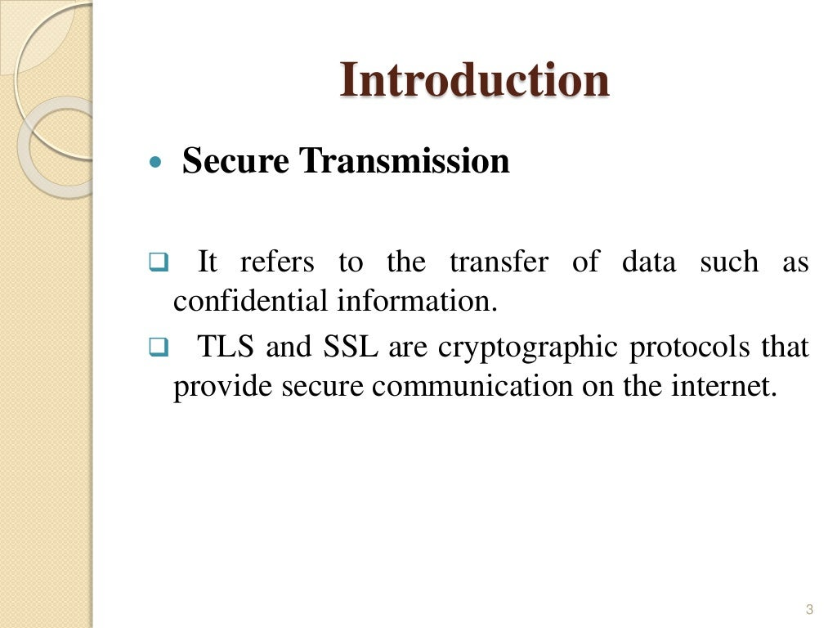

Slide 5
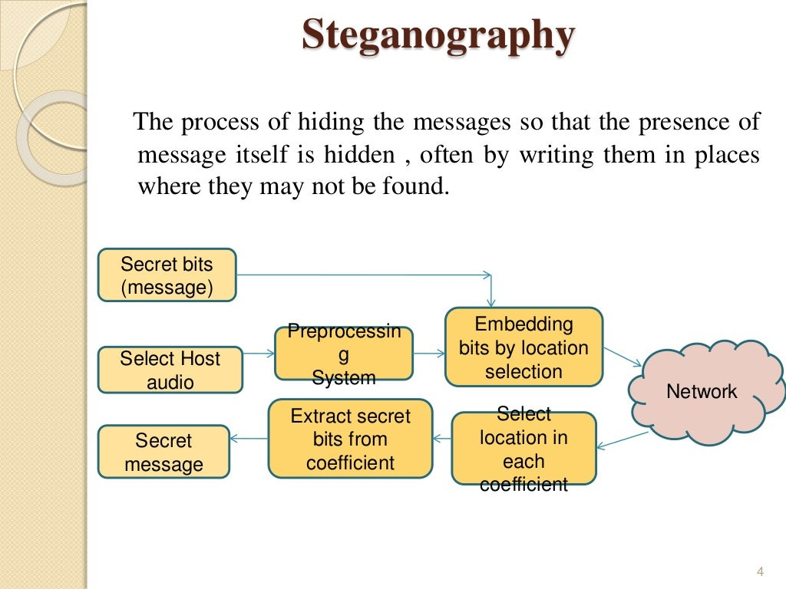

Slide 6
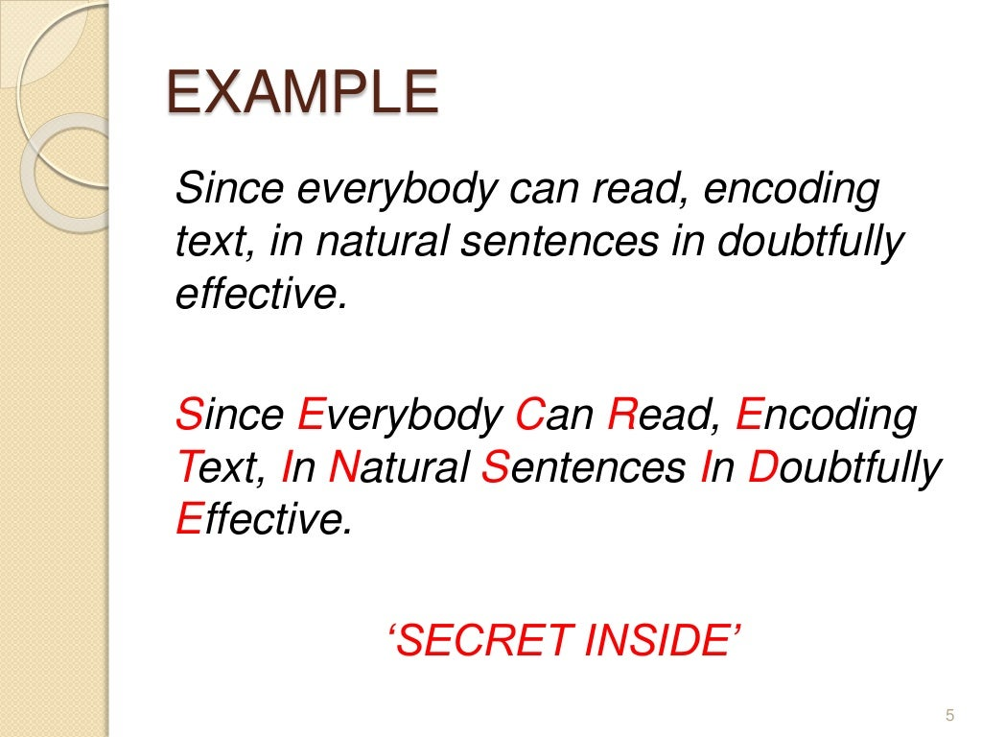

Slide 7
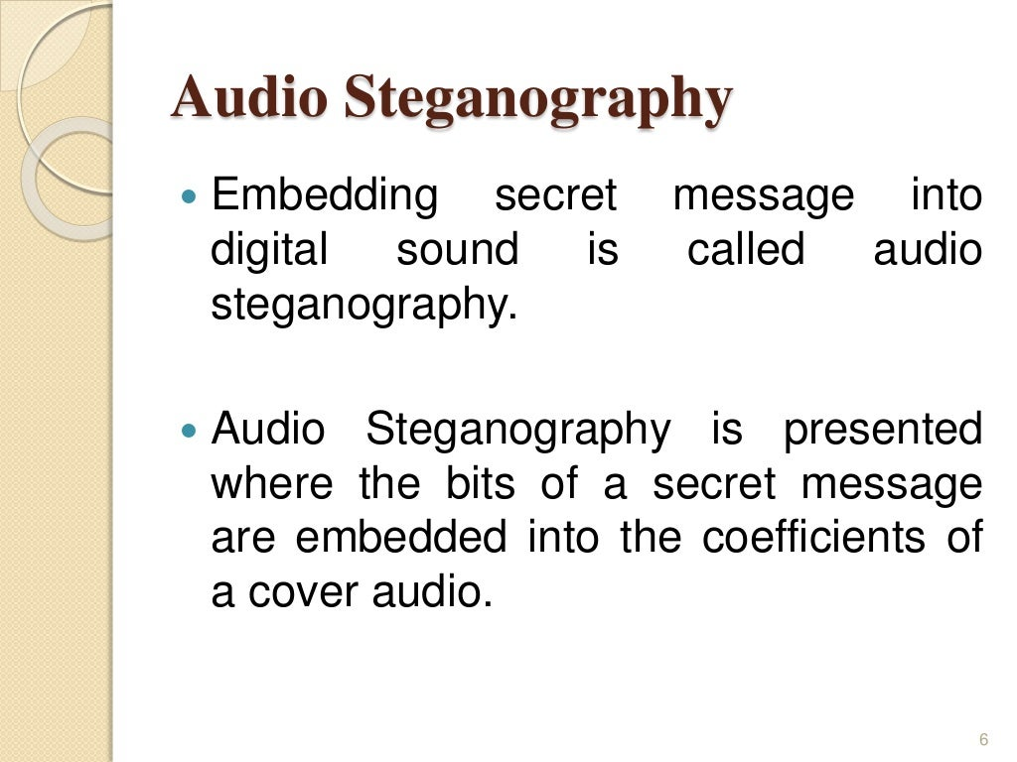

Slide 8
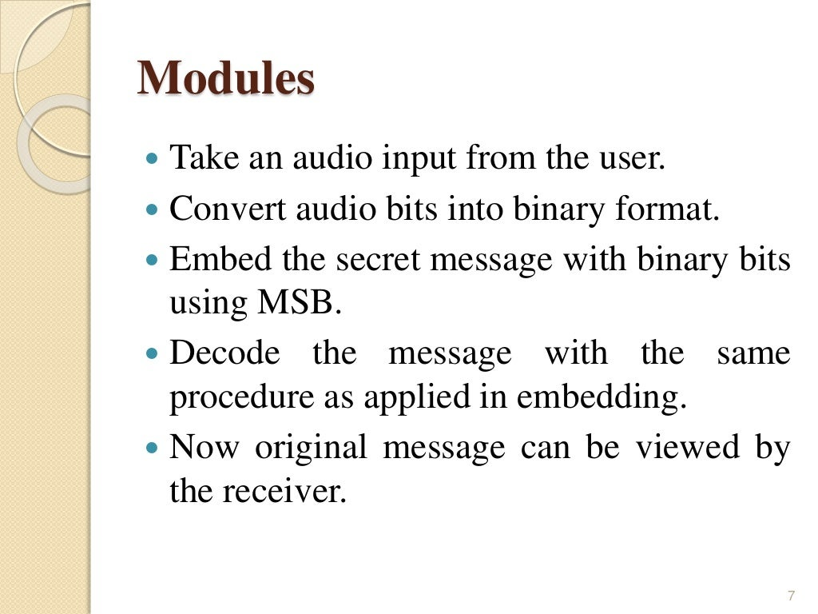

Slide 9
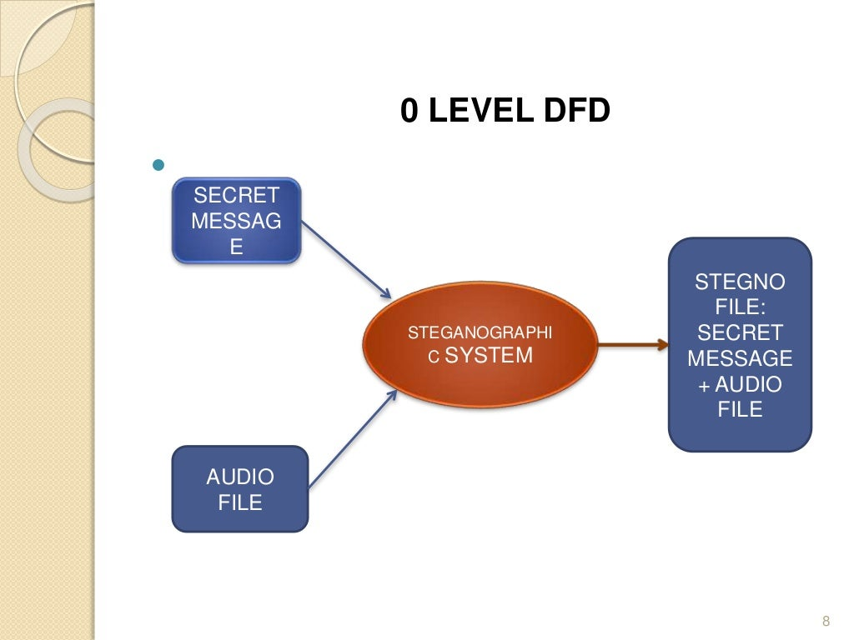

Slide 10
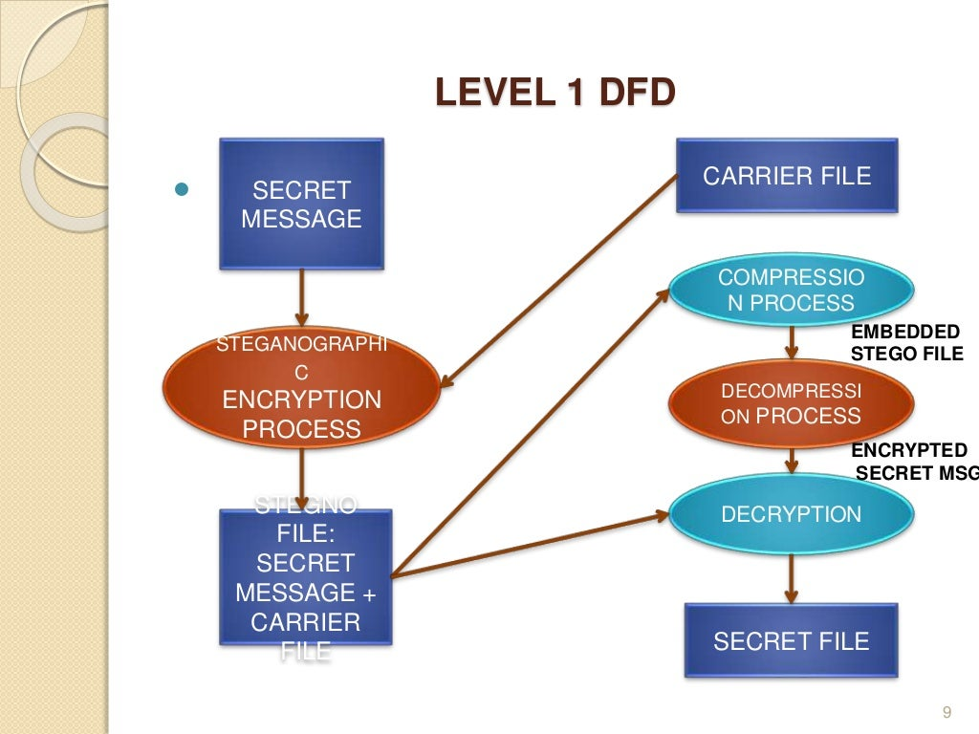

Slide 11
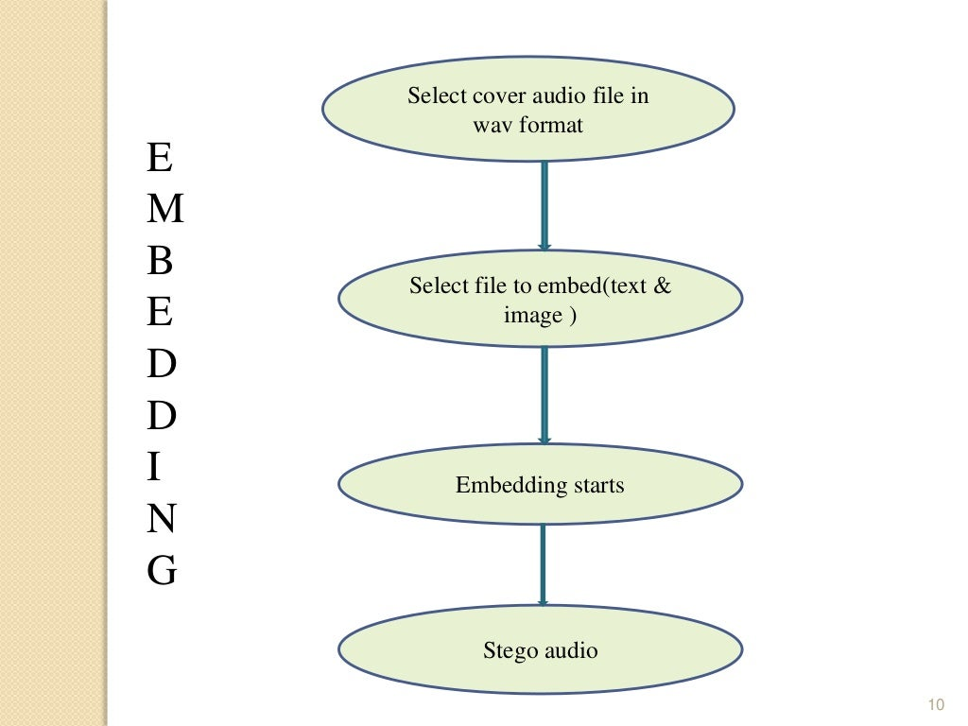

Slide 12
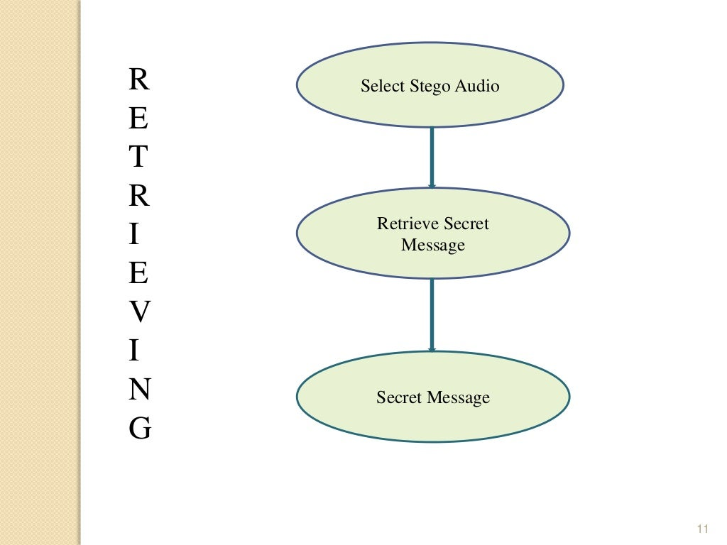

Slide 13
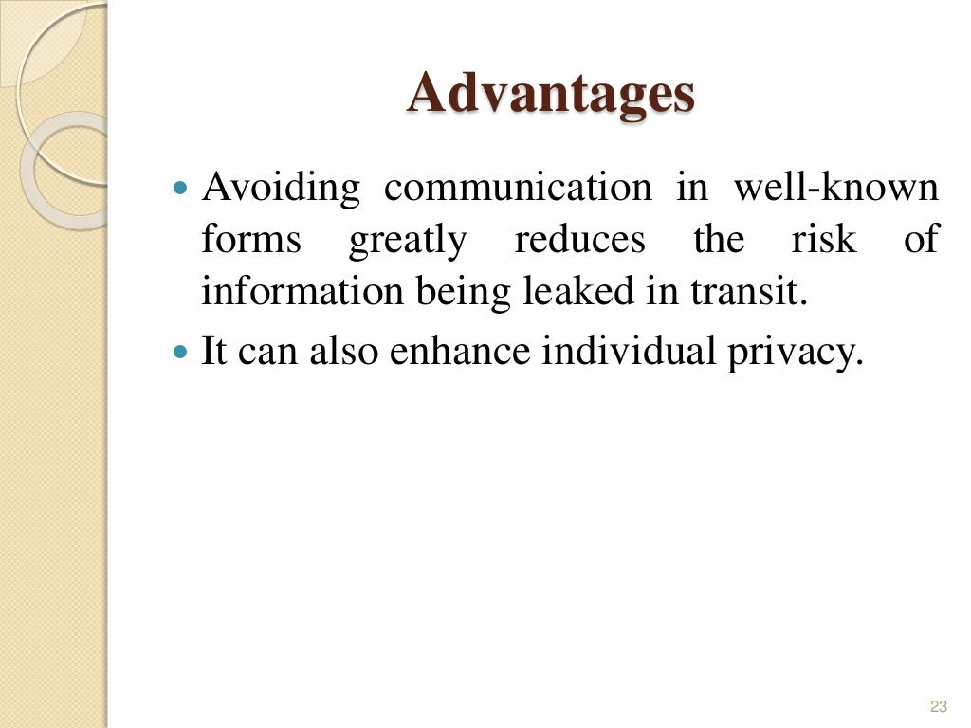

Slide 14
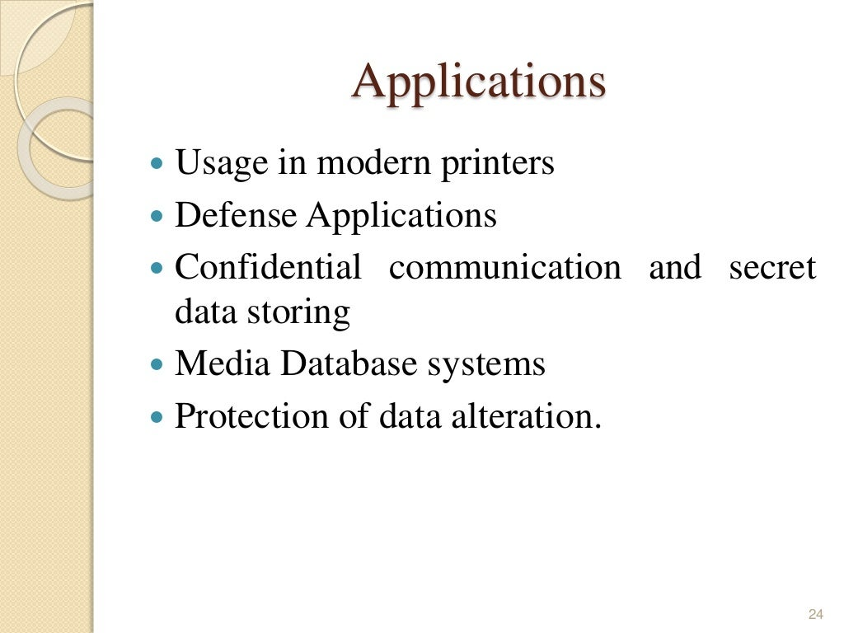

Slide 15
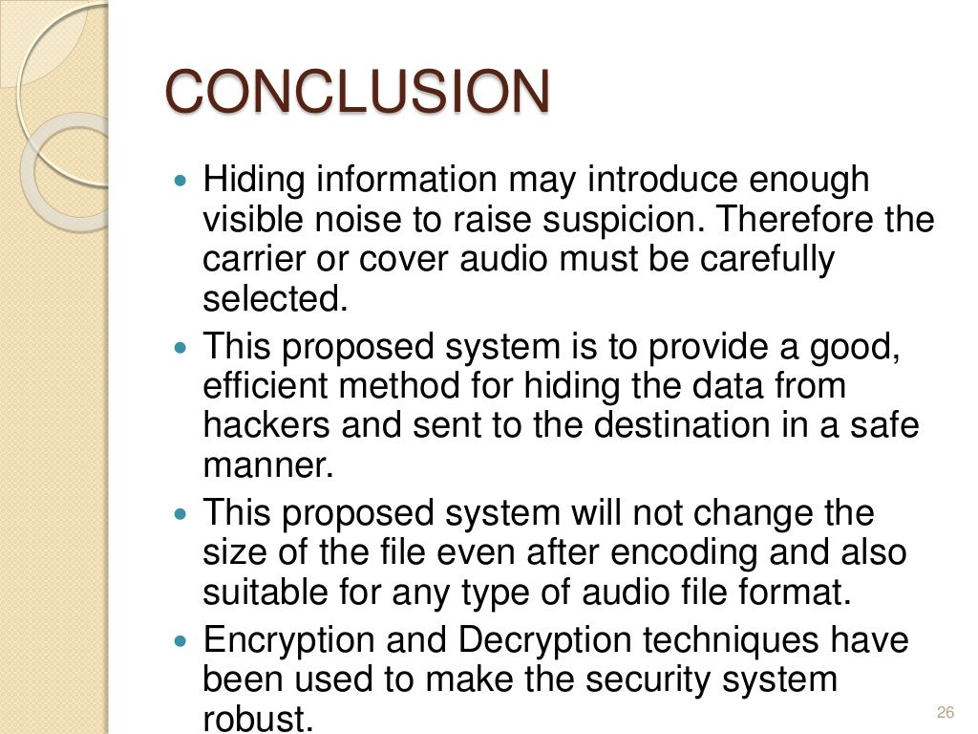

Slide 16


